Slide 1
Lipids Structure and Properties
1) Structure and Properties 2)Digestion, Absorption, and Transportation 3) Metabolism

Slide 2
Objectives
Understand the different roles of lipids in our bodies
Describe the structure and functions of fatty acids
Understand the nomenclature of fatty acids
Identify the subclasses of lipids in which fatty acids are constituents of
Describe the structure and functions of triacylglycerols (triglycerides)
Describe the structure and functions of cholesterol
Recognize that phospholipids are amphipathic and play an important role as structural components within our body

Slide 3
Lipids
Lipids have many functions in body
Structural and functional components of cells
Inflammatory response
Hormone production
Energy source
Insulation
Recommendations: 20-35% of energy intake per day
Type of fat consumed plays different roles on health
Saturated versus polyunsaturated fatty acid
IOM. 2002, Dietary guidelines 2010

Slide 4
Lipids
Low solubility in water
Some subclasses are amphipathic (e.g., phospholipids)
Subclasses of lipids
Different functions in the body
Different properties in food
Fatty Acids
Triacylglycerols (triglyceride)
Sterols (cholesterol)
Phospholipids

Slide 5
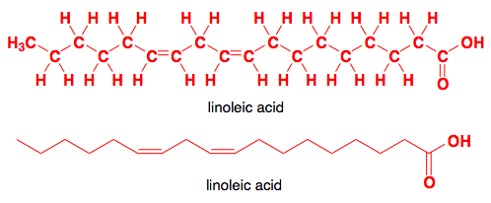
Fatty Acids (FA)
Component of more complex lipids
Triacylglycerols and phospholipids
Dietary cholesterol
Hydrocarbon chain (chain of hydrogen and carbons)
Carboxylic acid end (-COOH)
Methyl end (-CH3)
Omega carbon
Alpha Carbon
Omega Carbon

Slide 6
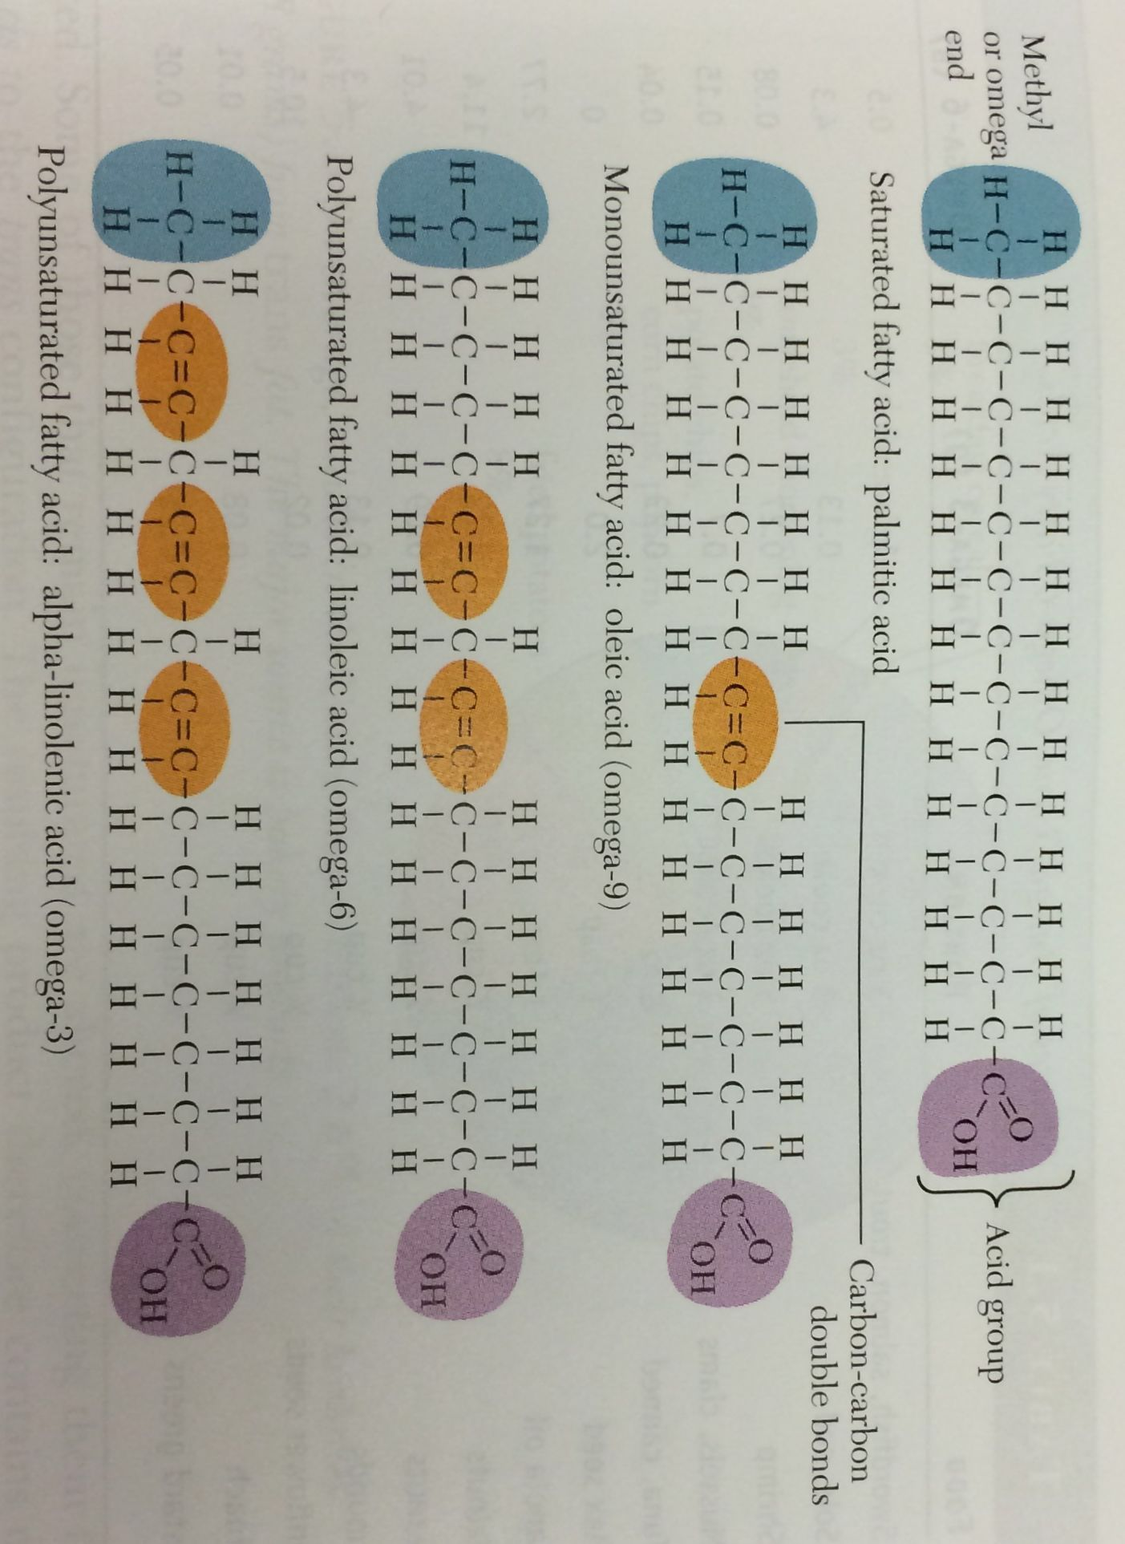
Fatty Acids - Saturation
Saturation
Saturated
No double bonds along HC chain
Carbons are completely saturated
Animal food sources: Dairy, meat products (beef, chicken, etc.)
Vegetable sources: palm kernal oil, coconut oil, peanut oil
Resistant to rancidity

Slide 7
Fatty Acids - Saturation
Saturation
Unsaturated: one or more carbons are not saturated
Monounsaturated: one carbon=carbon double bond
Food source: olive and canola oils
Polyunsaturated: two or more carbon=carbon double bonds
Example: linoleic and alpha-linolenic acids
Food sources: corn, safflower, soybean oils

Slide 8
Fatty Acids - Saturation
Unsaturated: carbon=carbon double bonding
Double bonds
Amount and placement differ among FA
Give FA biological role different than saturated
Saturated
energy source
higher melting point (solid at room temp) – butter
Unsaturated
inflammatory responses, cellular structure
lower melting point (liquid at room temp) – olive oil

Slide 9
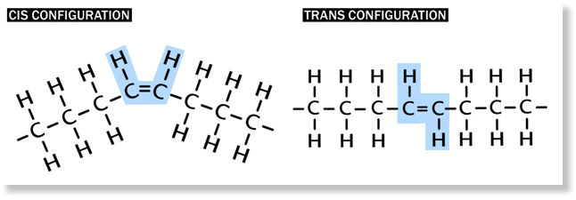
Fatty Acids
Cis or trans configuration – only in unsaturated FAs
Cis
Mostly naturally occurring
Hydrogens on same side of double bond
Induces folding and kinking of FA chain
Trans
Hydrogens on opposite sides
Induces linear formation: Resembles saturated FAs which are linear

Slide 10
Fatty Acids
Trans Fatty Acids
Some natural sources: beef, lamb, pork, milk
Fatty acids undergo hydrogenation
Term = fully or partially hydrogenated oils
Process:
Hydrogens added to HC chain = becomes more saturated– similar structure of saturated Fas
Cis altered to Trans form
Increases melting point and shelf life of food - stability
Average intake 8.1 g/day (US)
Implications in disease risk – acts more like a saturated fatty acid
AJCN. 2015

Slide 11
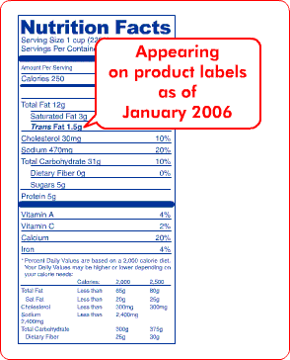
Fatty Acids
Trans labeling on nutrition labels
FDA requires Trans
labeling in 2006
AJCN. 2015

Slide 12
Fatty Acids Nomenclature
Delta system
How many – carbons, double bonds?
Carbon chain length - (18)
Number of double bonds - (2)
Where -
All double bond positions from carboxylic end
Example: linoleic acid
18:2
Δ
^{9,12}

Slide 13
Fatty Acids Nomenclature
Omega system
How many – carbons, double bonds?
Carbon chain length - (18)
Number of double bonds – (2)
Where -
First double bond position from methyl end (omega carbon)
Double bonds always separated by 3 carbons
Example: linoleic acid (AKA omega-6)
18:2
ω
-6

Slide 14

Carboxylic End (-COOH)
Methyl End (-CH3)
Delta System:
Omega System:

Slide 15
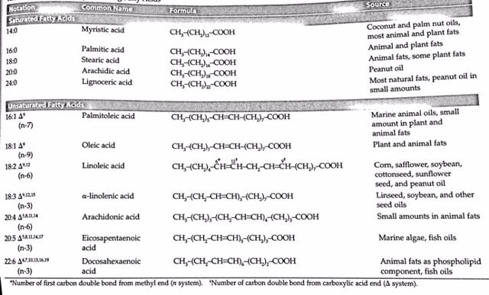
Fatty Acids
FAs with carbon chains >14 most abundant in dietary sources

Slide 16
Essential Fatty Acids
Diets without FAs result in adverse physiological outcome
Some unsaturated fatty acids cannot be synthesized in human cells thus essential in the diet
Acquire from plant sources
Linoleic acid (18:2 ω-6) (omega-6)
Alpha-linolenic acid (18:3 ω-3) (omega-3)
Acquire from fish oils
EPA and DHA (considered to be omega-3 FA)

Slide 17
Essential Fatty Acids
Acquire omega-3 and -6 from plant and fish sources
Humans lack delta12 and delta15 desaturases
(Omega-6)
Humans can not incorporate double bonds beyond carbon 9 from carboxylic end (delta end)
Alpha-linolenic acid (Omega-3)

Slide 18
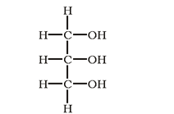
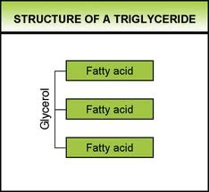
Triacylglycerols (Triglycerides)
Fat stored in our body is mainly in this form
95% of dietary fat
Acylglycerol
Glycerol esterfied to 3 fatty acids
FAs can be same or different
sn-1
sn-2
sn-3
Glycerol backbone– trihydroxy alcohol

Slide 19
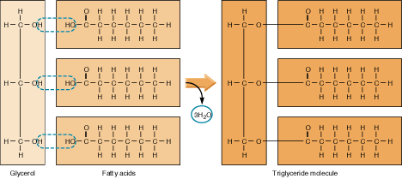
Triacylglycerols – esterification
Ester Bond
Glycerol
FAs
Triacylglycerol Molecule
O
||
R – O – C - R
Ester bond:

Slide 20
Triacylglycerols (Triglycerides)
Solid or liquids at room temperatures – dependent upon makeup of FAs
Short-chain and unsaturated
Liquid at room temp
Longer chains and saturated
Solid at room temp
FAs from triacylglycerols are energy source in human body
Free FAs released by lipases

Slide 21
Mono- and diacylglycerols
Acylglycerols (glycerol esterfied to fatty acids)
Monoacylglycerol
Diacylglycerol
Small amounts in tissue
Intermediates in
digestive and metabolic
pathways
H
Diacylglycerol

Slide 22
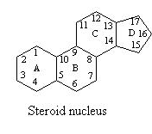
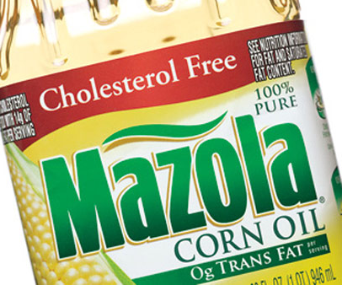
Sterols
Four-ring core - steroid nucleus
Most abundant – cholesterol
Animal origin
Meat, egg yolk, dairy
Majority of food sources contain cholesterol esters (cholesterol esterfied to FA)
Biosynthesis =
NOT essential

Slide 23
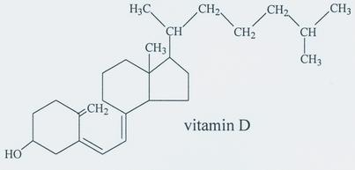
Sterols
Cholesterol functions
Essential component of cell membranes
Pre-cursor to many bodily compounds
Bile salts
Hormones: estrogen, androgen, progesterone
Vitamin D

Slide 24
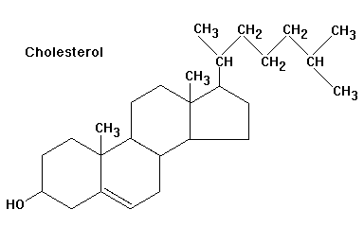
Sterols
Steroid nuclei differ by:
Arrangement of double bonds
in ring structure
Presence of hydroxy (C3)
or methyl (C10, C13) groups
Side chains located at C17
In dietary sources: cholesterol
typically esterfied to FAs
FA Esterification

Slide 25
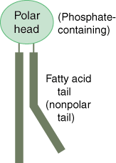
Phospholipids: Phosphoglyceride
Lipid containing phosphate
Phosphoglyceride
Glycerol backbone
Attached to 2 FAs and a
phosphate group
Amphipathic
Polar end – phosphate end
Non-polar – FA end
Ability to stabilize molecules in aqueous environments
Found in cell membranes – regulate the substances that pass in and out of cells

Slide 26
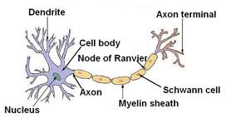
Phospholipids: Sphingophosphatides
Sphingomyelins
Important in central nervous system: composes myelin sheath of axons of neurons
Insulation of axons – conduct impulses/signals

Slide 27
Summary
Fatty acids are major source of energy from dietary lipids
FAs can be saturated or unsaturated (carbon=carbon)
Saturation changes the function of the lipid
FAs have nomenclature based on positions of double bonds (delta and omega systems)
Linoleic and alpha-linolenic acids intake is essential
Acylglycerols are made of a glycerol and up to 3 fatty acids by esterification
Triacylglycerols are abundant in diet and main form of fat storage
Cholesterol is made of a 4-ring steroid nucleus
Sterols differ by the make-up of the steroid nucleus
Phospholipids play an important role in cell membrane structure and in signaling from the central nervous system

Slide 28
Lipid Digestion and Absorption
1) Structure and Properties 2)Digestion, Absorption, and Transportation 3) Metabolism

Slide 29
Lipid Digestion and Absorption Learning Objectives
Describe the role of lingual lipase on lipid digestion in the stomach
Describe gastric lipase and emulsification processes that occur in the stomach
Describe pancreatic lipase and emulsification processes in the small intestine
Understand the role of bile salts in the formation of micelles
Identify the transport mechanisms of lipids across the apical and basolateral membranes
Describe reesterification processes in the enterocyte
Understand the formation and fate of the chylomicron and its role in lipid transportation
Describe what happens following the breakdown of chylomicron in circulation

Slide 30
Dietary Lipids
Triacylglycerols
Main lipid of diets
Provides essential FAs (polyunsaturated)
Average daily dietary intake:
Men: 95g
Women: 65g
Sterols (cholesterol) and phospholipids
Cholesterol average intake 300 mg/day (animal products)
1-2 g/day of phospholipids
NHANES 2000-2006

Slide 31
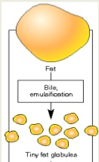
Lipids
Hydrophobic molecules -- challenge to travel through aqueous environments
Digestive mechanisms required to increases solubility of lipid particle
Mechanical forces - emulsification
Bile salts
Emulsification processes
Stability factor
Fat
Emulsification
Fat Globules

Slide 32
Triacylglycerol Digestion: Mouth and Stomach
Lingual lipase
Glands under tongue
Stimulated by neural factors, high
fat diets, mechanical motion in mouth
Works in low pH (stomach)
No actual digestion occurring in mouth

Slide 33
Triacylglycerol Digestion: Stomach
Lingual lipase – active in stomach
Specific to:
Short-chained FAs on triacylglycerols
sn-3 of glycerol
Produces diacylglycerols and
free FAs
sn-1
sn-2
sn-3
Glycerol

Slide 34
Triacylglycerol Digestion: Stomach
Gastric lipase
Secreted by chief cells
Works best in low pH (stomach)
But can continue to work in upper small intestine
Specific to sn-1 and-3 of glycerol
Produces di- and monoacylglycerols and free FAs
sn-1
sn-2
sn-3

Slide 35
Triacylglycerol Digestion: Stomach
Emulsification – breaking large
lipids into smaller lipids
Starts in stomach
Peristalsis
Wear and tear through sphincter
Fat
Emulsification
Fat Globules

Slide 36
Triacylglycerol Digestion: Small Intestine
Lipid droplets and digestive products enter small intestine
90% of lipid digestion occurs in small intestine
Efficient emulsifiers – bile salts
Allows for greater availability of lipases to reach triacylglycerides
Specific lipases – require less acidic environment

Slide 37
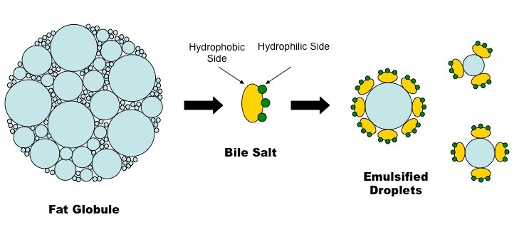
Triacylglycerol Digestion: Small Intestine
CCK stimulates release of:
Bicarbonate and lipases from pancreas – part of pancreatic juice
Bile from gallbladder
Bile made of bile salts
Amphipathic particles
Partition to surface of droplet
Hydrophobic end
Hydrophilic
end

Slide 38
Triacylglycerol Digestion: Small Intestine
Pro-colipase secreted by pancreas
Activated by trypsin to colipase (co-enzyme) in small intestine
Colipase required for pancreatic lipase to recognize and bind substrates
Colipase allows pancreatic lipase to bind to lipid droplet = hydrolytic action on droplet
Colipase deficiency – results in lipid malabsorption
Trypsin
Activation of P. lipase
Pro-colipase
Colipase
Pancreatic lipase

Slide 39
Triacylglycerol Digestion: Small Intestine
Pancreatic lipase activity
–Specific to sn-1 and -3 FA of triacylglycerol
- Longer-chained FA
Products include:
Di- and monoacylglycerols
Free fatty acids
With peristaltic agitation of stabilized, bile-surrounded droplet and chemical enzymatic action = efficient
emulsification
sn-1
sn-2
sn-3

Slide 40
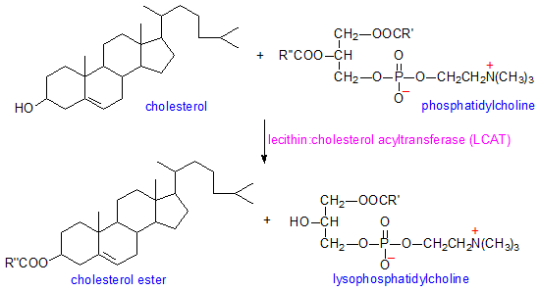
Cholesterol Digestion
Sterol esterase: cleaves fatty acid from cholesterol ester
In small intestine
Esterase
Esterified cholesterol
Cholesterol + Free FA
Fatty acid

Slide 41
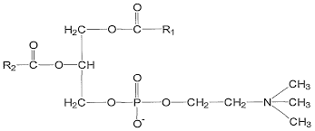
Phospholipid Digestion
Pancreatic phospholipase
Phospholipase A2 specific to sn-2 of phosphatidylcholine
Most predominate dietary phospholipid is phosphatidylcholine
Phospholipase A2
Phosphatidylcholine
lysophosphatidylcholine + Free FAs
Fatty acid
Fatty acid

Slide 42
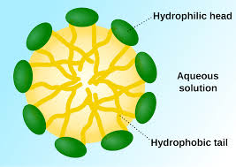
Small Intestine
Products in small intestine:
Fatty acids
Mono- and diacylglycerols
Cholesterol
Phospholipids
Micelle Formation
Micelle

Slide 43
Small Intestine: Micelle
New products of small intestine will combine with bile salts to form micelles
diacylglycerol
phospholipids
FA
monoacylglycerol
cholesterol

Slide 44
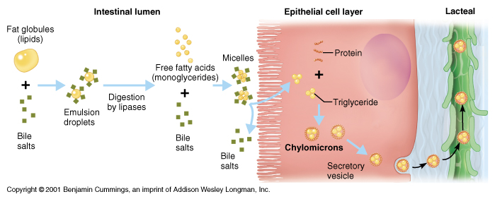
Absorption: Small Intestine
Micelle is stable and water-soluble
Penetrate unstirred water-layer at enterocyte
Digested lipids
products

Slide 45
Absorption: Small Intestine
Lipid contents diffuse out of
micelle
Cross apical membrane by
diffusion (concentration gradient)
Bile salts move to ileum
Recirculation (enterohepatic
circulation)
Ileum → hepatic portal vein →liver → gallbladder

Slide 46
Absorption: Small Intestine
Digested lipids in enterocyte
FAs with <10 carbons are more soluble
Diffuse into circulation → liver
Transported to liver by albumin
FA with ≥10 carbons reform (reesterification) into:
Tri, di-, and monoacylglycerols
Cholesterol esters

Slide 47
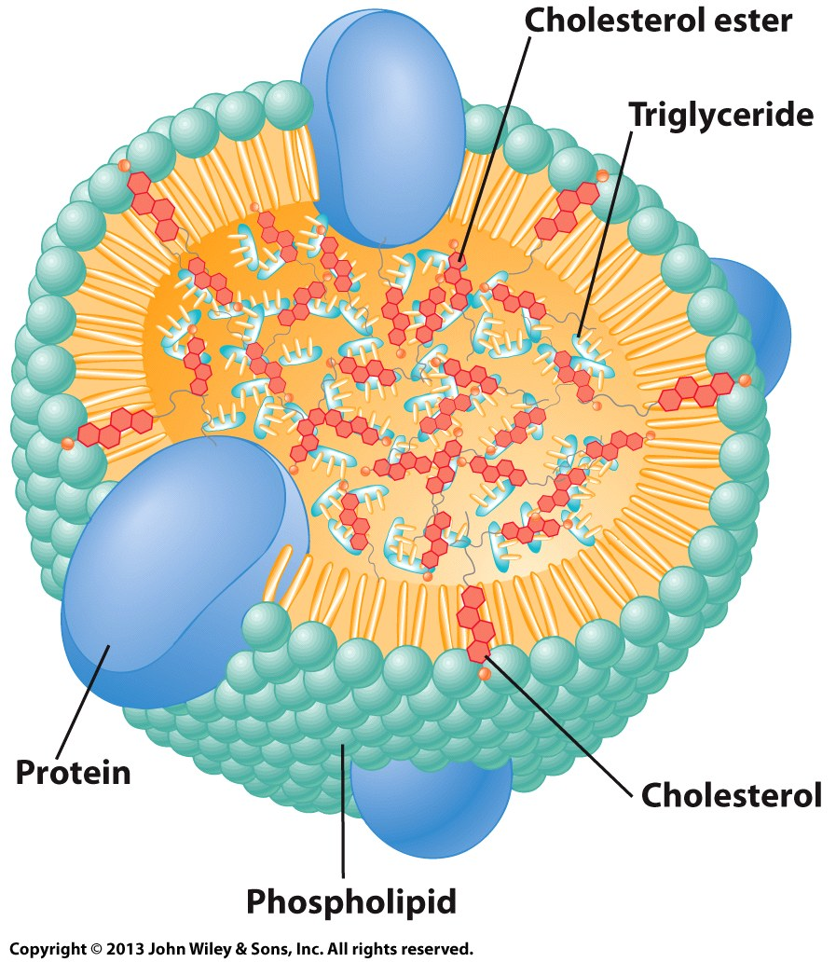
Absorption: Small Intestine
Re-esterfied lipids and long-chained fatty acids form a chylomicron
Transporter of re-esterfied lipids and long-chained fatty acids out of small
intestine
Chylomicron gains a
protein coat – thus
considered to be a lipoprotein

Slide 48
Absorption: Small Intestine
Apolipoprotein: protein that stabilize lipid particle in aqueous environments
Named by apo + series of letters (A-E) + number
Examples: apoB-100, apoE, apoB-48, etc.
Apolipoproteins have other physiological functions important for lipid metabolism:
Stimulate enzymatic reactions
Regulate metabolic functions
Specificity towards receptors
LDL contains apo100
apo100 specific to the LDL Receptor (LDLR)

Slide 49
Absorption: Small Intestine
Apolipoproteins specifically synthesized in enterocyte – apoB-48 and apoA-1
Surround reformed lipids as part of the chylomicron
In the enterocyte: chylomicron consists of:
Mono-, di-, triacylglycerol, cholesterol esters, cholesterol long-chained fatty acids (in the center of chylomicron)
Apos: apoB-48 and apoA-1
Phospholipids

Slide 50
Absorption: Small Intestine
Apolipoprotein A-1
Chylomicron lipid
arrangement
Hydrophobic lipids
in center of molecule
Hydrophilic (proteins and
phosphate groups)
situated at surface
Apolipoprotein B-48

Slide 51
Chylomicron – Lipid Transportation
Chylomicrons too large to enter capillaries
Exits basolateral membrane into lymphatic circulation
Exocytosed through basolateral membrane via secretory vesicle
Chylomicron bypass liver and enter circulation via lymph system
In circulation: chylomicron picks up additional apos: C and E

Slide 52
Chylomicron in Circulation
Apolipoprotein A-1
Apolipoprotein C
Apolipoprotein B-48
Apolipoprotein E

Slide 53
Chylomicron – Lipid Transportation
Chylomicrons travel mainly to adipose tissue and muscle
Lipoprotein lipase (LPL) – enzyme in endothelial membrane of adipose and muscle tissues
ApoC helps LPL recognize lipids
Hydrolyzes FA from mono-, di-, and triacylglycerols of chylomicron
Fatty acids enter tissues
Product of lipoprotein lipase: Chylomicron remnant – rich in cholesterol
Chylomicron remnant travels to liver

Slide 54
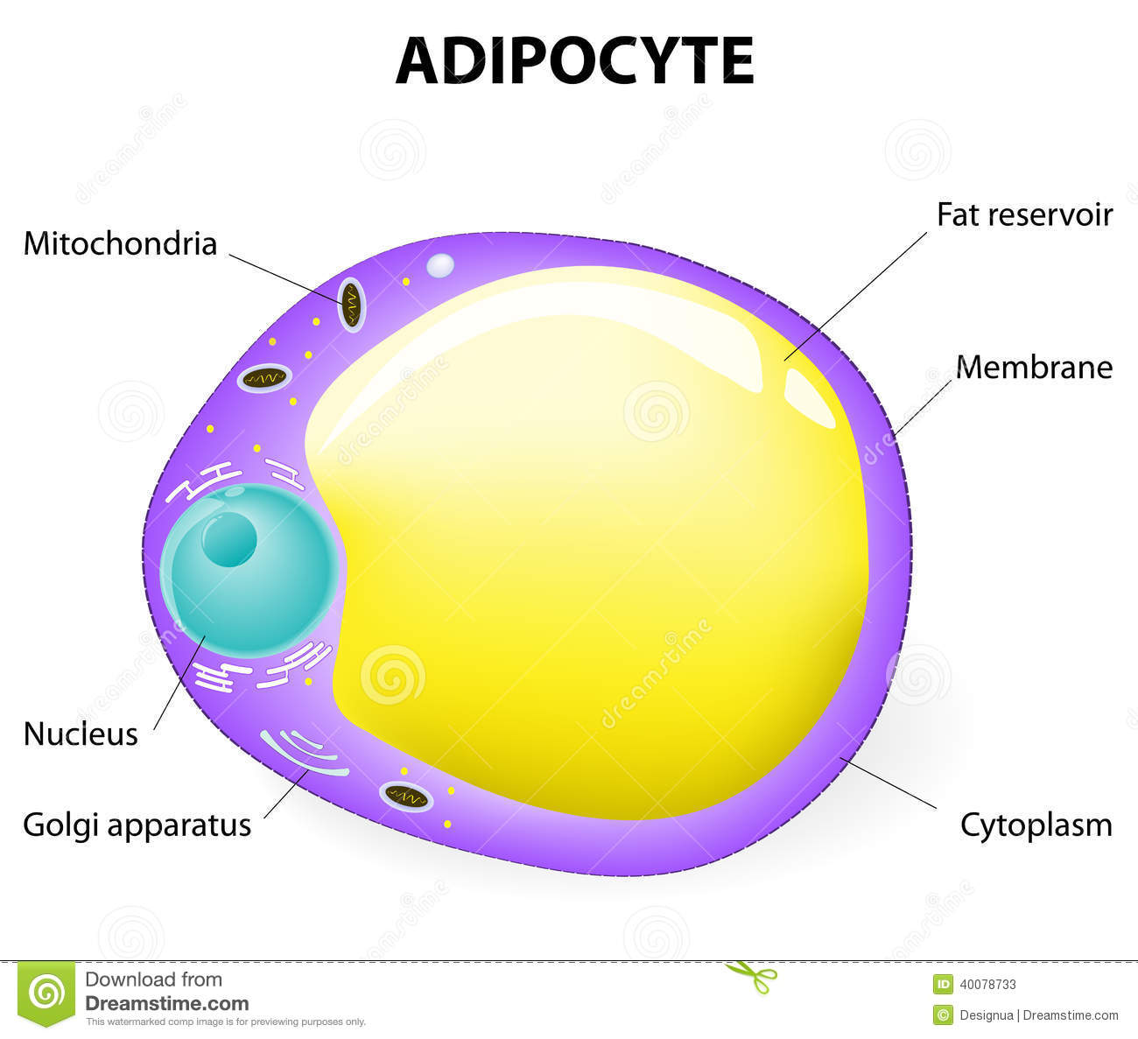
Distribution of Lipids
Muscle: FFA
Oxidized for energy
Adipose Tissue: FFA
Major storage site of
triacylglycerols (85% of
adipocyte)
Chylomicron Remnant: cholesterol rich
Chylomicron
Chylomicron
Enterocyte → Circulation → muscle and adipose tissue → Liver

Slide 55
Chylomicron – Lipid Transportation
Chylomicron remnant – rich in cholesterol
Removed from blood stream by receptors specific to apoE on liver
Very low density lipoprotein (VLDL) made in liver
Main transporter of cholesterol and some endogenous triacylglycerols from liver
Lipoprotein lipase (activated by apoC) present in blood – strips VLDL of triacylglycerol
Results in IDL → LDL
LDL deposits cholesterol into body’s cells

Slide 56
Transportation in Circulation – Lipoproteins
Lipoprotein characteristics:
Density of particle – physical characteristic to classify lipoproteins
Low to High:
Chylomicrons < VLDL < IDL < LDL < HDL
http://oregonstate.edu/dept/biochem/hhmi/hhmiclasses/biochem/figsch18/fig18p7.html

Slide 57
Transportation in Circulation – lipoproteins
1. Chylomicrons -transport dietary lipids from intestines to tissues
2. Very Low Density Lipoproteins (VLDL) – transport endogenous triacylglycerol and cholesterol from liver to tissues
3. Intermediate Density Lipoproteins (IDL) – transport cholesterol to liver forming LDL
4. Low Density Lipoproteins (LDL) – transport cholesterol to tissues
5. High Density Lipoproteins (HDL) - transport endogenous cholesterol from tissues to liver

Slide 58
Summary
Lipases are enzymes that work to breakdown large lipids to smaller lipids
Lingual/gastric (low pH to function) and pancreatic (higher pH to function) lipase
Lipases, bile, and mechanical forces efficiently emulsify lipids
Micelles made of digested lipids and bile salts form at the brush border
Aides in successful absorption across apical membrane of enterocyte by stabilizing in aqueous environment
Digested lipids (>10 FA HC chain) are reesterfied in enterocyte
Digested lipids form chylomicron - contains apolipoproteins and phospholipids – before being absorbed across basolateral membrane
Enter lymph system
Transportation of chylomicron results in chylomicron remnant which is cholesterol rich
Chylomicron remnant continues transporting cholesterol to tissue
Eventual formation of IDL, LDL, and HDL

